Slide 1
Cell Signaling & Receptors
Lecture 7

Slide 2
Objectives
Understanding of 5 “communication paradigms” in cell signaling
The nature of signals or hormones
Features of receptors, membrane or not; domains
Signal amplification and 2nd messengers
Examples of signaling systems
G-protein coupled receptors
Tyrosine kinase-based receptors
Steroid receptors
Phosphorylation role in signaling

Slide 3
Topics
General features of signaling
Hormones / Ligands / (Neuro)transmitters
Receptors
Signal Transduction & Amplification
2nd Messengers
Specific examples of signaling
G protein-Coupled Receptors
Protein Kinase Receptors (Receptor Tyrosine Kinases)
Steroid Hormones & Their Receptors

Slide 4
Cell Signaling
Unicellular organisms (prokaryotes & unicellular eukaryotes eg amoeba, paramecium) have the ability to signal other individuals of community
But they act as individuals
Multicellular organisms have tissues, organs, and systems that must coordinate physiologically
So these cell signaling systems developed as they are now

Slide 5
Terms / Definitions / Descriptions
All terms used in cell biology
Ligand
a molecule binding another, usually larger molecule
Agonist
a chemical binding to and activating a receptor
Hormone
a biochemical transported in blood or other tissue fluid which stimulates specific cells or tissues into action
you might see ligand, agonist, hormone used interchangeably

Slide 6
Communication Paradigms
Direct cell-to-cell and cell-matrix contact
binding of ligands on surface of one cell to the receptors on another, with no release of a freely diffusible subtance; could include formation of specialized syncytial structures
Synaptic signaling
release of a freely diffusible signal into an intercell gap to cause a change in state of the target cell: e.g., serial nerve impulse transmission, stimulate muscle contraction or other function
Paracrine signaling
release of a freely diffusible signal traversing the interstices (cells nearby, within same tissue) to activate neighboring cells

Slide 7
Communication Paradigms
Autocrine signaling
cell releases a signal that acts on itself
Endocrine signaling
release of signal into the systemic circulation

Slide 8
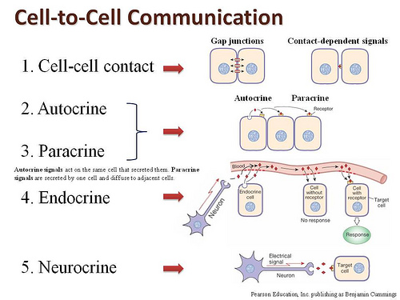

Slide 9
Signals / Hormones
Types of signals and cells producing them
Small non-protein molecules
acetylcholine: CNS neurons
epinephrine: chromaffin cells (adrenal medulla)
estrogen, testosterone: ovaries, testes
Small peptides
insulin: pancreatic beta cells
Proteins
fibroblast growth factor (FGF): many cells
insulin-like growth factor (IGF): also many cells

Slide 10
Receptors
The signal, or agonist or hormone or ligand, will fit like key-into-lock with a receptor
Receptors are invariably proteins that bind to the signal and generate a response
Responses can involve
activation of one or more metabolic pathways or cellular functions
simultaneous inactivation of other pathways, particularly those that work at cross purposes
Receptors often are membrane proteins, located on surface waiting for signal to bind
Can be located intracellularly, with lipophilic signal passing through cell membrane

Slide 11
Cell Membrane Receptors
Transmembrane proteins typically with more than one subunit (polypeptide)
Extracellular domain: Receptors bind to ligand / agonist / hormone on the outside of the cell (extracellular side)
Transmembrane domain has segments pass through the binding
Intracellular domain: it might be an enzymatic part (with catalytic activity) or it might bind to another molecule (protein or otherwise) for the purpose of initiating
A domain of a protein is a functionally (and usually structurally) distinct part of a protein that fits into the whole of the function of the protein

Slide 12
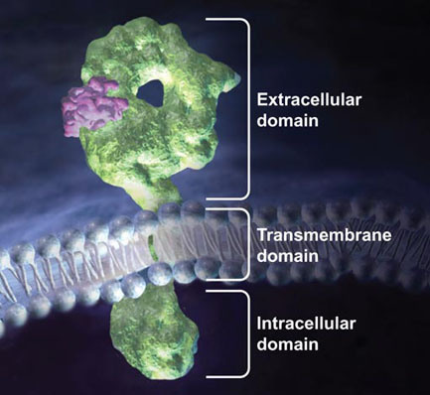
Membrane Receptor Domains
This happens to be a model for a classical membrane receptor, where the extracellular domain binds a growth factor and the intracellular domain has enzymatic activity as a protein tyrosine kinase (it phosphorylates tyrosine side chain –OH group of proteins)
Growth factors are mitogens (cause a signal to induce mitosis & cell proliferation)

Slide 13
Membrane Receptor Types
Receptor Channel/Transporter/Pump/Carrier
A receptor protein that functions as a pore permitting usually a specific substance (ion: Na⁺, Cl–, K⁺)
But note that in most cases, receptors will start an intracellular response that changes function of channel/transporter/pump membrane proteins downstream (i.e., many membrane protein functions not directly integrated within a receptor in the same protein)
Receptor Enzyme
The receptor has an intracellular domain that has catalytic activity (is an enzyme)
G-protein-Coupled Receptor (model)
The hormone-receptor complex binds to other proteins that help propagate the signal
Integrin/Cell Adhesion Molecule (CAM)-Type Receptor
Transmembrane proteins that typically bind ligands on membrane surface of other cells or to to extracellular matrix molecules outside and connect with cytoskeletal elements inside (typically)

Slide 14
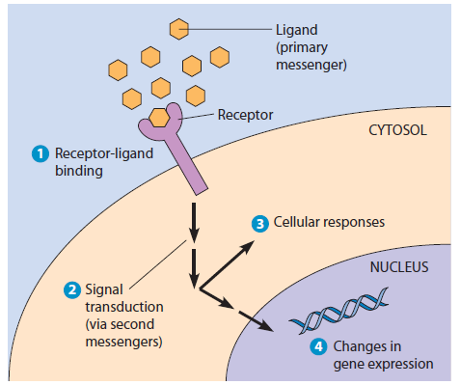
Transduction
etymology: "act of leading or carrying over"
a signal transduction has the effect of using an intermediary (in biology, receptor) that converts the extracellular stimulus to an intracellular form of the stimulus, eliciting the response

Slide 15
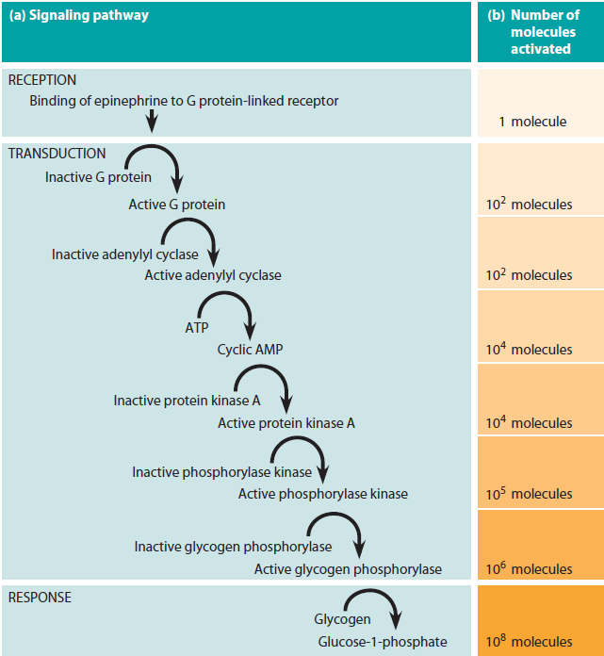
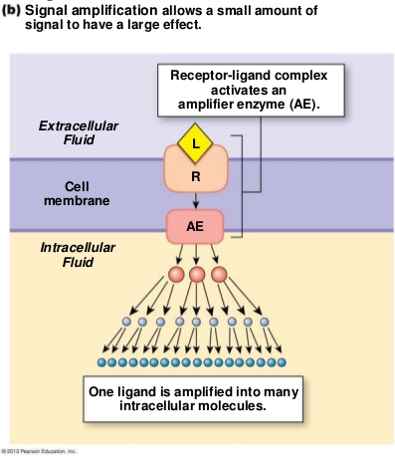
Signal Amplification
A few single molecules as signals (hormones) would take too long to take a tour of a cell to cause it to change its function/physiology, which must involve hundreds to thousands of molecules being mobilized within seconds
A system in place that creates a cascade of molecules stimulating/interacting with other
molecules on a multiple series of levels does a much better job of amplifying the response within the required time frame

Slide 16
The 2nd Messenger
1st messenger = hormone/agonist interacting with receptor outside cell
2nd messenger = biomolecule formed or activated by activated receptor that moves through intracellular space interacting with "downstream" cell components
The interaction of downstream components with the 2nd messenger might turn them on or off
The purpose is to achieve an altered physiological state in the cell
Note, not all signaling requires or involves a clear 2nd messenger
Nerve impulse conduction!
Insulin release from pancreatic beta cells?

Slide 17
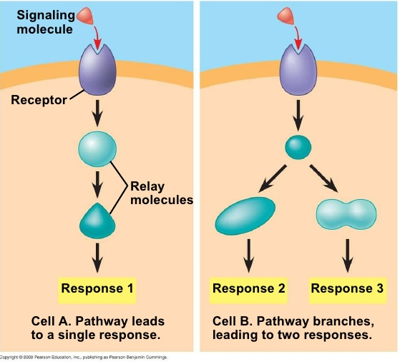
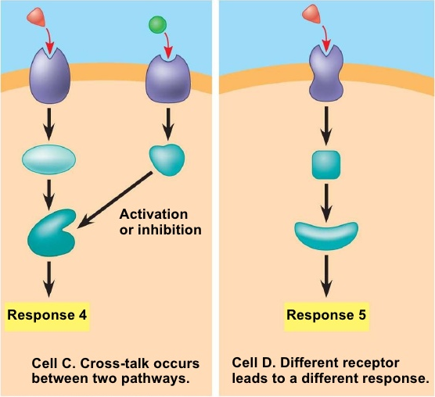
Modes of Response(s)
A single cell stimulus can lead to just one observable response, often through one pathway (cell A in figure)
Or it might lead to two responses, possibly stimulating two pathways to achieve these (cell B)
If there are two external stimuli, the 2nd stimulus might augment/activate/modulate up the stimulus of another responsible for response generation. Or it might inhibit or modulate down the response (cell C)
The hormone may also bind to a 2nd receptor type that produces an entirely different response in the cell (cell D)

Slide 18
G Protein-Based Signaling
The description of the G protein-based system is somewhat involved because it is first necessary to describe the components before how it works
The components are
the receptor
the G proteins
the targets
Their descriptions follow

Slide 19
G Protein-Coupled Receptors
Several separate proteins (polypeptides) are involved in the signaling using GPCRs
The receptor
a transmembrane protein with 7 transmembrane (TM) segments, all alpha helices
N-terminal side outside cell, C-terminal side inside cell
Loops of the polypeptide interact with certain G proteins
If the G protein-binding loops of the activated receptor are phosphorylated, then the receptor won't bind the G protein (turning off the receptor from continuing the transduction)

Slide 20
The G Proteins & Targets
The G Proteins
These are two classes of these
Multi-subunit proteins: actually 3 subunits called alpha (G_{α}), beta (G_{β}), and gamma (G_{γ}). They come together to form a heterotrimer (hetero "different" tri "three" mer "parts")
Ras: this is a single polypeptide (monomer)
These two classes both bind GTP or GDP (hence the name G proteins): the G_{α} subunit bind the GTP in the multisubunit protein, not the beta & gamma
To make it more complicated, the G_{αβγ} complex can have two types: G_{s} for stimulating G proteins and G_{i} for inhibiting G proteins
Targets
generally other membrane proteins

Slide 21
How GPCR Signaling Works
Hormone/ligand binds the receptor
Receptor changes its conformation
Changed conformation leads to G protein complex binding the receptor
The G_{α} subunit, which already has a bound GDP from a previous signaling, releases the GDP
The G_{α} subunit now binds a GTP
sometimes steps 4 and 5 are called a GDP-GTP "exchange"
The subunits beta and gamma subunits are now unbound complex G_{βγ} from G_{α}
The G_{α}-GTP and/or the G_{βγ} can bind targets, and separately initiate signalling events

Slide 22
Adenyl Cyclase
Adenyl cyclase is a very important membrane protein that catalyzes the reaction of forming cyclic AMP (cAMP) from ATP
Adenyl cyclase is activated by a G protein (G_{α}-GTP) complex, discussed on previous slides
The cAMP will go on to activate a protein kinase called the cAMP-dependent protein kinase, or protein kinase A (PK-A): two cAMP molecules will each bind to two regulatory (R) subunits and release the two catalytic (C) subunits of PK-A, which will phosphorylate many proteins
This series of activations/reactions is described because of the historical importance of identifying PK-A and its role as a protein in cell signaling; G protein details were discovered much later

Slide 23
Turning The Signaling Off
The signaling is active while the G_{α} has a GTP bound to it
When the GTP is hydrolyzed to form GDP and phosphate, with the GDP remaining bound to G_{α}, then G_{βγ} re-associates with G_{α}-GDP and their separate activities are shut down
The G_{α} subunit has its own catalytic activity to hydrolyze GTP (to GDP + P_{i}), but does it slowly. Some proteins can associate with G_{α} to increase the GTP hydrolysis activity
The type of activations by the G protein subunits and the period the activations last depend on the cell type and functions to be deployed

Slide 24
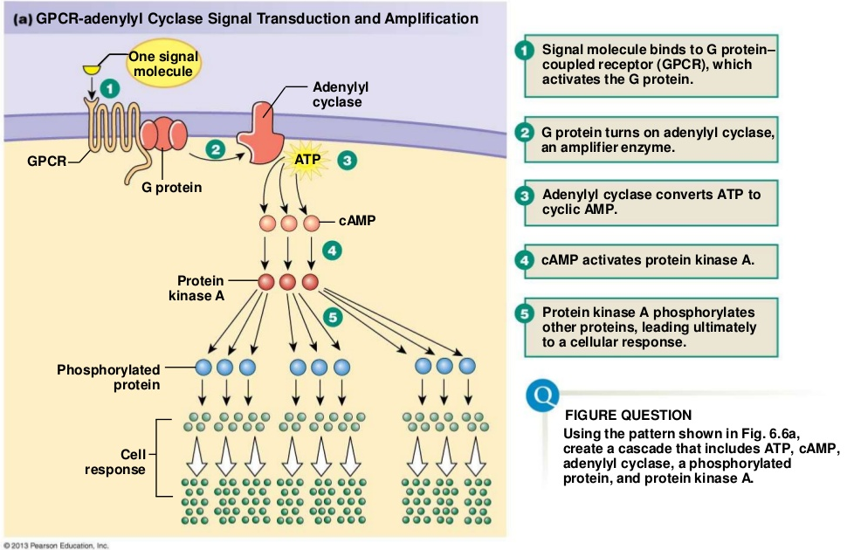

Slide 25
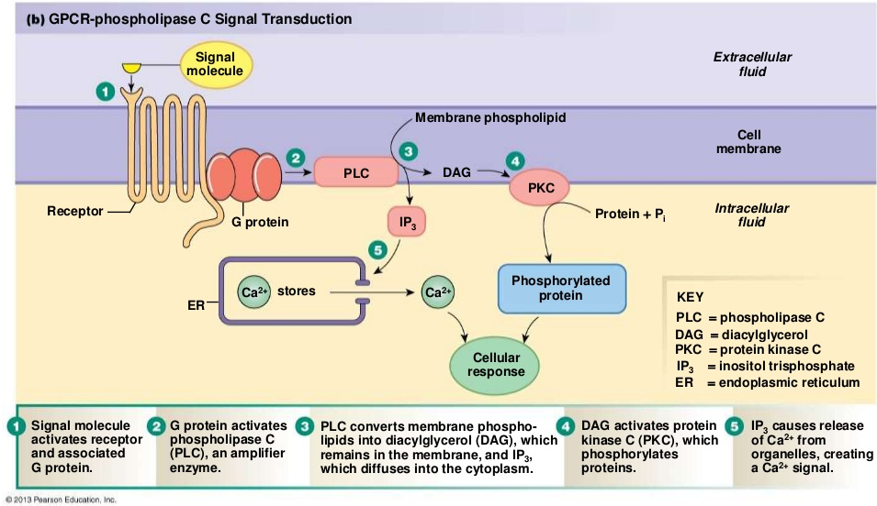
G protein-coupled activation is responsible for many other important signaling pathways well-known to cell biologists which are not covered in this course. The one below is for Ca²⁺-activated proteins and its role as a 2nd messenger

Slide 26
Receptor Tyrosine Kinases
The receptor is a transmembrane protein with three domains as described in a previous slide
Extracellular domain: this is the part that binds the ligands; RTK ligands are typically proteins called growth factors
Growth factors are small polypeptides, typically dimeric, with identical subunits. They induce mitogenesis, which means the receptor tyrosine kinases are usually involved in cell proliferation
Transmembrane segment: a single spanning segment connecting the domains on both sides of the cell membrane
Intracellular domain: this has an enzymatic (catalytic) activity as a protein kinase that phosphorylates tyrosine residues (the hydroxyl groups of the Tyr side chain) of target proteins

Slide 27
RTK Activation & Function
The ligand growth factor binds a receptor
The dimeric nature of the growth factor means that only one of the monomers binds. The other one waits for another receptor molecule to traverse the membrane and bind to it.
The 2nd receptor molecule now aggregated with the proteins, the tyrosine kinase starts to phosphorylate Tyr residues on the protein kinase's own intracellular domain (this is called autophosphorylation)
When autophosphorylation is complete, there are several P-Tyr (phosphotyrosine) residues

Slide 28
RTK Activation & Function
Each of these P-Tyr on the RTK can bind different proteins floating around in the cytosol. The P-Tyr-binding portion of the cytosolic proteins are called SH2 domains. When one protein binds to the RTK P-Tyr, it becomes activated, and initiates a pathway that might generate a 2nd messenger (or not) that causes a metabolic change
Because several different proteins can bind to each of the P-Tyr residues of RTKs, they can start several different pathways
Overlap: RTKs also activate pathways that G-proteins activate by their receptor system

Slide 29
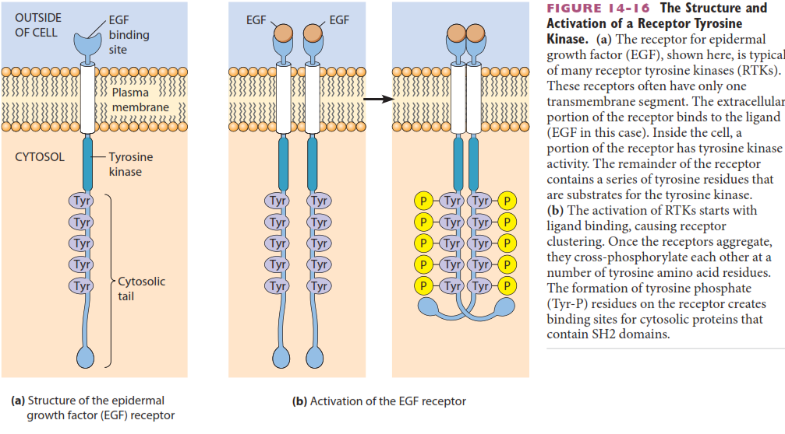
The figure shows how RTKs, such as the epidermal growth factor (EGF) receptor, binds to EGF and how receptor molecules dimerize, then autophosphorylate to produce an active protein kinase

Slide 30
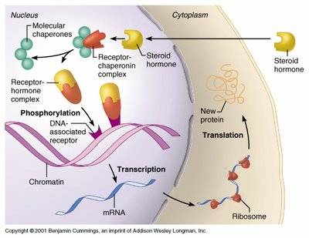
Steroid Receptors & Signaling
The steroid molecule is a hormone signal which is lipophilic and can thus traverse through cell membranes
The steroid binds to its receptor in one of two places:
cytoplasm, after which the complex moves to nucleus
nucleus, in which case hormone also traverse nuclear membrane
Binding of steroid hormone to receptor releases a group of proteins (molecular chaperones, also called heat shock proteins) that stop the receptor from acting alone until the hormone is bound
The hormone/receptor complex binds directly to DNA in the cell genome which regulate gene expression, causing those genes to be transcribed into RNA and then synthesized into protein

Slide 31
Time of Response
Cell signaling system is optimized for the time of response
Synaptic transmission in order to propagate nerve impulses is on order of milliseconds
The membrane receptors typically generate a response ranging from milliseconds to minutes
Where multiple responses occur, this range is especially true
The intracellular steroid receptor starts a slower response—gene expression—which can take from minutes to hours

Slide 32
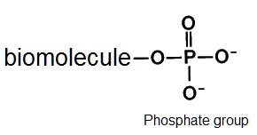
Phosphorylation
Among the many and most important biochemical reactions in a cell involve phosphorylation
Phosphorylation is the transfer of a phosphate molecule to another biochemical
This bond form is called a phosphate ester (because phosphate is an acid itself)
Dephosphorylation is the removal of a phosphate molecule, usually by H₂O: phosphate ester hydrolysis
These reactions occur inside cells, not outside them

Slide 33
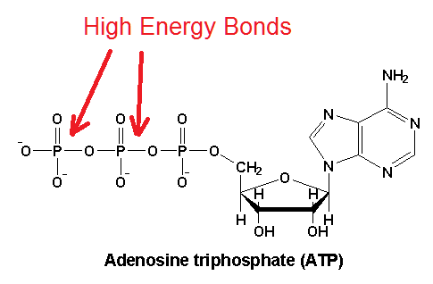
Adenosine Triphosphate (ATP)
ATP is a molecule used by the cell to store energy it derives from the metabolism of glucose
That energy is used to drive metabolic pathways that require energy
The phosphorylation (transfer of phosphate) to other biomolecules is a process requiring energy to make it happen

Slide 34
Kinases / Phosphatases
Kinases are names given to enzymes that catalyze phosphorylation reactions. These enzymes transfer a phosphate from ATP to the substrate. Substrate is another name for the reactant of an enzyme catalyzing the biochemical reaction
Kinases are more formally and understandably named phosphotransferases (phospho-, -transfer-, -ase: enzyme that transfers phosphate) but old nomenclature has a difficult way of ending
Phosphatases are enzymes that catalyze dephosphorylation reactions, usually by hydrolysis to remove the phosphate group
Protein kinases are enzymes that phosphorylate proteins (with ATP of course)
Protein phosphatases are enzymes that dephosphorylate proteins (by hydrolysis of course)

Slide 35
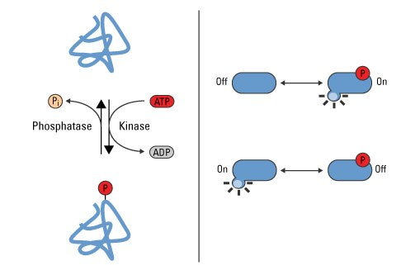
Proteins Being Modified
These protein substrates being modified by phosphorylation and dephosphorylation are many kinds of proteins
enzymes: changes their activity (on or off, up or down)
structural proteins: changes structure, perhaps binding (on or off, up or down)
membrane proteins: open or close a pore perhaps
Putting on phosphate or taking it off changes state of protein
Don't assume that putting on phosphate turns on: it may turn off!
It just changes state

Slide 36
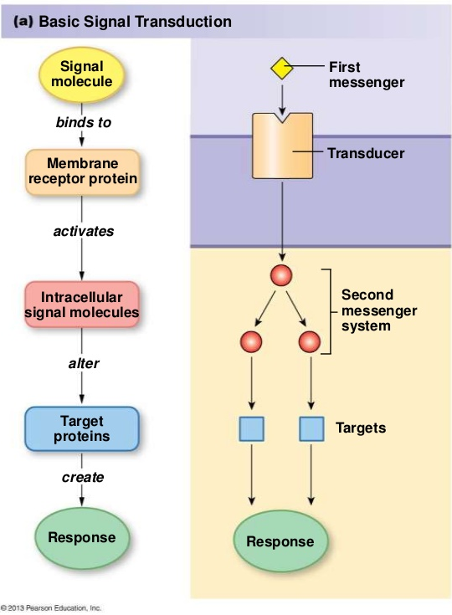
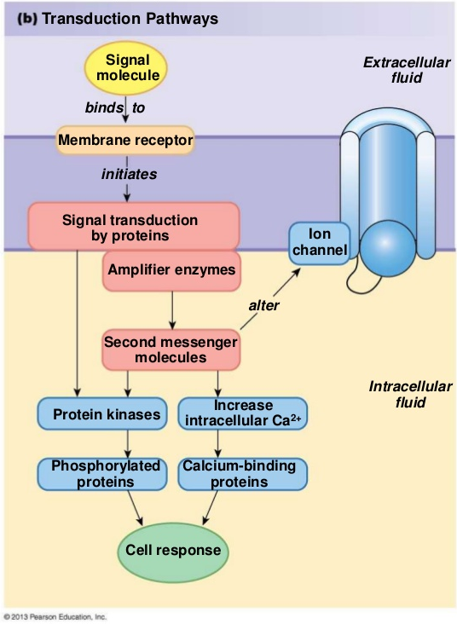

Slide 37
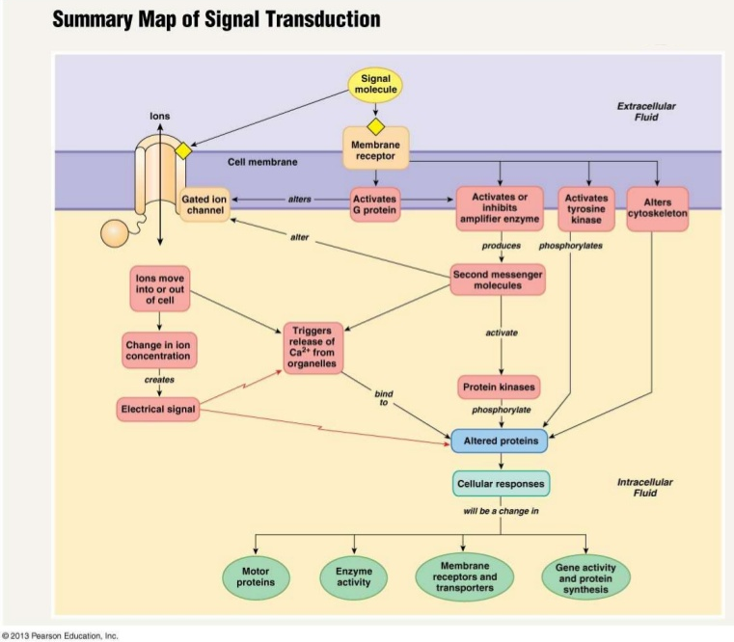

Slide 38
Reading (Sources)
Raven: Chap 9
Becker's WotC: Chapter 13, 14

